Slide 2
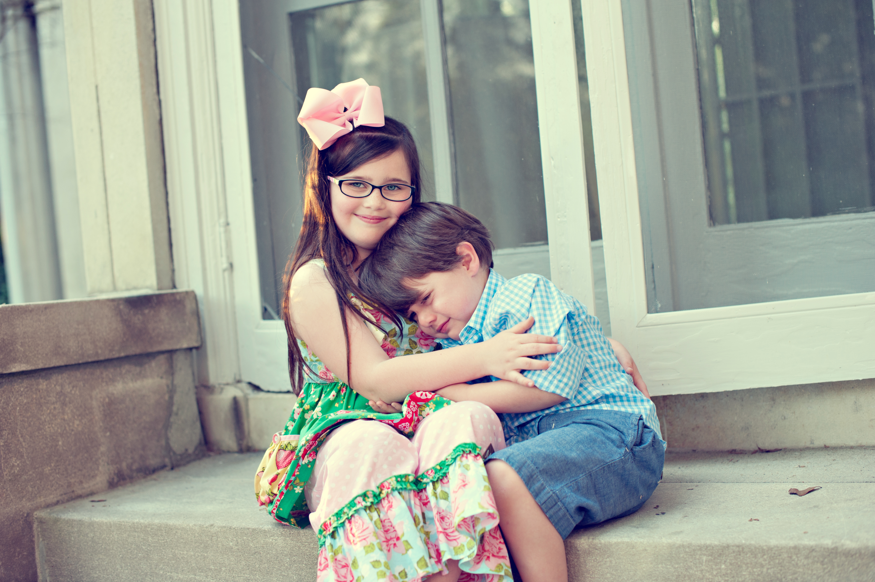
Mrs. Brooke Hunt, M.Ed. NBCT
Notes:
You can include a picture of yourself, your family, and share some information about yourself with your new families and students.

Slide 3
My cell – 901.596.7740
My email – hunthb@scsk12.org
School Office – 901.416.2148
Please provide your email & cell number
on the sign-in sheet!
*note/phone call for absence (3 days)*
Notes:
Include Names, phone numbers and emails of important school personnel. It could be your principal, assistant principal, secretary, and nurse.

Slide 4
8:05 Arrival/Announcements/Journals
8:30 Morning Meeting
Reading Block
11:05 Lunch
11:35 Recess
12:15 Math
1:15 Intervention/Enrichment/Rest/Snack
2:05 ENCORE
3:10 Dismissal
Notes:
Share your daily schedule!

Slide 5
A – Act Safely
B – Be Responsible and Respectful
C – Care for Yourself, Others, and your Environment
D – Do your Best at All Times
We use logical consequences, fix-it, and take a break time.
*BEE BINDER CALENDARS*

Slide 6
Please see the Richland website for the school supply list
Wish List/Necessary but not required: Chlorox wipes, copy paper, scrapbook supplies, Sharpies, Flair Pens, playdough…
Backpacks (appropriate size, need a change of clothes EVERYDAY…) and a pack of white t-shirts
Donor’s Choose
Gift Cards: Amazon, TPT, Hobby Lobby, etc.
Notes:
Share supply lists or even extra supplies that you are requestion

Slide 7
Students can arrive at school as early as 7:45 to eat breakfast.
*if you are not in OASIS, your child may not be dropped off or enter the building before 7:45*
School Hours 8:05-3:10*
*please be on time to pick up your child*
Students are late at 8:20!
After 8/13, students will walk down by themselves from the front hallway at the top of the stairs.
If your child has trouble separating, try to arrive right at 8:05 and let them walk in with the line.
Notes:
Make sure parents know what time the first bell rings and when the tardy bell rings. Let them know the earliest time that students can be dropped off and what they do when they get there.

Slide 8
Breakfast is free for all SCS students.
Students can arrive no earlier than 7:45 to eat breakfast in the cafeteria.
Notes:
Include breakfast prices, where they can pay, where they can find a breakfast menu

Slide 9
Our lunch time is 11:05 – 11:35.
You may bring lunch and eat with your child during this time after the 1st 9 weeks.
Your child may bring his/her lunch OR get a tray lunch (not both)*
Notes:
Include lunchprices, where they can pay, where they can find a lunch menu

Slide 10
All students need to bring a refillable water bottle everyday with WATER.
Snack calendar – each student will bring (21) snacks
If you forget – Send next day!
Notes:
Explain your expectations for snack time: will you have class/group snacks or will each student be responsible for bringing their own snack each day

Slide 11
KK dismissal is 3:10
We dismiss outside the red double doors.
If there is a change, please
CALL THE OFFICE.
Notes:
Let parents know what time the bell will ring for dismissal and what pick up procedures are. I also always include a little note that they should email me AND call the office is there is a change in what they normally do after school. I may not get to my email in the afternoon so letting the office know is always very important

Slide 12
Please feel free to share any concerns or ask me any questions!
Email, notes, texts – are fine!
Please – no texts or phone calls during the school day!
Technology is a great tool for communication!
Remind app, sign up genius, SEESAW …
Notes:
Share how you will be communicating with your parents this year. Do you have a daily folder? Weekly? Share your email and your school number. Here I would also share if you have any social media for your class: facebook, instagram, twitter, etc.

Slide 13
Wish List (will create on Amazon)
Donor’s Choose class grant
TPT or Amazon
Hobby Lobby or scrapbook donations
Special sign-ups for Theme Studies
Pack of T-shirts
Notes:
Here I would include the items that you ALWAYS ask for or could use that is NOT on your supply list.

Slide 14
Titles for Tomorrow (PTO)
Special Snack Day
Birthday Lunch
Parent Reader
Invitations welcome for whole class, or all boys/all girls… (join PTO)
No balloons, cupcakes…
Notes:
How will you recognize students’ birthdays this year. Share specific information! That way there is no question about what is acceptable and what isn’t.

Slide 15
Thanksgiving Feast
Winter Party
End of the Year Party
*Mrs. McNary – big on limiting edible treats for non-party days, but I can usually work around calling it a work station*
Notes:
Let them know what other classroom parties are and dates if you have them available

Slide 16
Room Parent
Assistant Room Parents
Binder Helpers
Scrapbook Helpers
T-shirt Helpers (for field trips)
Special Day Station Assistants
*volunteer sign-ups usually begin in October*
Notes:
How will you use volunteers? Let parents know jobs that you may have them do. How will you be sending out that information to parents?

Slide 17
Zoo Field Trip
(Halloween)
Spring Field Trip
*$ due 30 days prior*
Notes:
You can give tentative or specific information here.

Slide 18
Parent Teacher Conferences
Refer to the SCS Calendar
scsk12.org
Refer to the PTO calendar
Notes:
Other important dates: programs, field days, etc

Slide 19
Eureka Math
(also called EngageNY)
Calendar Math Routines
Math Journals
Math Stations iReady/Zearn
Notes:
How you use this is up to you. You can share your standards/expectations here, or you can share pictures of what your math area looks like…or both!!

Slide 20
Science is embedded in our Reading Block.
Themes – Plants, Polar Animals…
Monthly STEM/STEAM Projects
Notes:
How you use this is up to you. You can share your standards/expectations here, or you can share pictures of what your science area looks like…or both!!

Slide 21
30 minute
Daily Writing Block
Stages of Writing
Handwriting Instruction
Notes:
How you use this is up to you. You can share your standards/expectations here, or you can share pictures of what your writing area looks like…or both!!

Slide 22
Reading/Language Arts
Whole Group
Guided Reading Groups
Work Stations
RTI/Intervention
Assessments
Notes:
How you use this is up to you. You can share your standards/expectations here, or you can share pictures of what your reading area looks like…or both!!

Slide 23
Our social studies curriculum is embedded into our reading/language arts block.
Notes:
How you use this is up to you. You can share your standards/expectations here, or you can share pictures of what your social studies area looks like…or both!!

Slide 24
We use a lot of technology in this class!
iPods, iPads, Macbooks…
Apps, programs, assessments...
Smartboard, interactive sites...
Notes:
Share what types of technology you will be using in your classroom here.

Slide 25
We have (2) music teachers
(2) 30 min. music classes/week
*Monday & Tuesday
Mrs. Fiveash
Notes:
Include a picture of your Music teacher, what days you have Music, and maybe some expectations

Slide 26
We have (2) P.E. teachers!
(2) 30 minute classes/week
Wednesday/Friday
2-2:30
Notes:
Include a picture of your PE teacher, what days you have PE, and maybe some expectations

Slide 27
Mrs. Ferkin – Librarian
30 minute class/week
*will be able to check out a book
*must return book on Library Day to be able to take books home
Notes:
Include a picture of your Librarian , what days you have Library, and maybe some expectations

Slide 28
We have (2) Art teachers!
(2) 30 minutes classes/week
Tuesday/Thursday
Notes:
Include a picture of your Art teacher, what days you have Art, and maybe some expectations

Slide 29
KK does not go to the computer lab!
Assessments
Using a computer mouse
Notes:
Include a picture of your Computer teacher, what days you have Computer Lab, and maybe some expectations

Slide 30
There is not a school nurse!
If your child is sick, you will be called to come. Refer to the handbook for policy info. *Please don’t tell them to call if they don’t feel better!* TEXT ME!
*change of clothes*
Notes:
Share school health policies here

Slide 31
Standards-Based Grading
Progress Reports 2nd, 3rd, 4th
Benchmark Assessments
PORTFOLIO
Informal Assessments
Daily Calendar (Conduct)
Notes:
Share grading policies here and maybe report card dates

Slide 32
Responsive Classroom
Phone Calls, Notes,
Office Referrals
(for severe behavior)
Notes:
What do you use in your classroom? Share your plan here. Pictures are helpful too.

Slide 33
Monthly Homework Packets (differentiated)
Theme-Based Projects
(optional)
*unless finishing work is a problem behavior in class
Notes:
Share homework policies here.

Slide 34
Refer to Richland Handbook
Shirts – white, red or gray
NO NAVY
Bottoms – navy, black, khaki
NO NAVY POLO DRESSES
*change of uniform clothes*
Notes:
Hit on the major dress code policies here

Slide 35
*Same rules apply outside
*Use of logical consequences
*water bottle
*inside playtime during inclement weather
*please allow independent playtime at the playground
Notes:
Here I always remind parents when we go outside and to send their child in weather appropriate clothing

Slide 36
All medications must be given in the office!
*must get appropriate form from office/signed by doctor*
Please let me know if your child takes any med at home (i.e. cough)! It helps keep me informed!

Slide 37
Richland has many family fun events. During the school year we will have family science and math night, family reading night as well as many other family oriented activities.

Slide 38
Volunteers and visitors must sign in the office and pick up a visitor’s badge.
*PLEASE do not sign in to walk your child down in the mornings.

Slide 39
We will have a rest time every day
(usually 1:15-1:45).
Even if a child does not go to sleep, it’s essential for brain development to have some “down time”!
You may send a small blanket or towel and lovie that will be kept in the backpack!

Slide 40
B.E.E. BINDERS (“Bring Everything Everyday”) help keep us organized. The three-ring binder houses homework packets, take home papers, snack calendars and other items that assist with communication between home and school.
Please do not remove the papers from the plastic sleeves (middle).

Slide 41
*Remind App
(sign up with email or phone number)
*Sign Up Genius
(this will go to your email)
*SEESAW app
*Change of Clothes!!!

Slide 42
*AR points – students must be able to read the books independently to take the tests
*Decodable readers may come home to target certain skills
*Practice reading high frequency words
Notes:
Let parents know how long they should be reading with their child every night

Slide 43
*Work Stations
*Task Cards are differentiated; only the answer sheet may come home
*Students are encouraged to make choices
Notes:
What are some fun games that parents can play with their children to help reinforce the math skills that you are working on in your classroom

Slide 44
*We want to build confident writers in KK!!!
*encourage creative (inventive) spelling!
*please don’t “tell them how to spell it”
Real Key to Early Literacy
Notes:
Give suggestions on how to get their child to write at home

Slide 45
*Given that info, sight words are still on the KK report card
*Some kids will not learn to read phonetically
*If you will practice 2 to 3 a week, it won’t be as overwhelming!
Notes:
You can share sight words that are expected here and maybe some fun ideas for them to do at home

Slide 46
*walking down, unpacking…
(help the stagger day & first day)
*kid-friendly lunches
*checking to see if work is being completed at school, conduct skills, etc.
Notes:
Let parents know what they can do every night to help their child become an independent and responsible student: packing own snack, getting clothes ready the night before, making sure homework is done.

